Slide 1
Digital Portfolio
STUDENT NAME: NARESH KUMAR J
REGISTER NO AND NMID: 222404566 B061837334334A1BAFA440FB6379BF53
DEPARTMENT: BSC SOFTWARE APPLICATION
COLLEGE: COLLEGE/ UNIVERSITY

Slide 2
PROJECT TITLE : STATIC STUDENT PORTFOLIO

Slide 3


AGENDA
Problem Statement
Project Overview
End Users
Tools and Technologies
Portfolio design and Layout
Features and Functionality
Results and Screenshots
Conclusion
Github Link
3/21/2024 Annual Review

Slide 4

PROBLEM STATEMENT
Problem Statement
To create a static portfolio for a student project that effectively demonstrates a student's skills, knowledge, and potential to a target audience (e.g., a potential employer, university admissions committee, or a scholarship board).

Slide 5

PROJECT OVERVIEW
Based on the provided information, here is a project overview for the static portfolio solution:
Project Overview: Static Student Portfolio
1. Project Title: Static Student Portfolio
2. Problem Statement: To design and create a static portfolio that effectively showcases a student's skills, knowledge, and potential to a specific target audience (e.g., potential employers, university admissions committees, or scholarship boards).
3. Project Goal: The primary goal is to develop a curated, high-impact portfolio that serves as a professional snapshot of the student's best work. This portfolio will not be a constantly updated document but a polished, finished product designed to tell a specific story and achieve a specific outcome, such as securing an internship, a job, or admission to a program.
4. Target Audience:
Potential Employers/Recruiters: Looking for evidence of practical, job-relevant skills, problem-solving abilities, and a professional work ethic.
University Admissions Committees: Assessing the student's academic growth, research skills, critical thinking, and potential for success in a higher-level program.
Scholarship Boards: Evaluating the student's accomplishments, leadership qualities, and future potential to determine eligibility for funding.

Slide 6

WHO ARE THE END USERS?
Potential Employers/Recruiters: Looking for evidence of practical, job-relevant skills, problem-solving abilities, and a professional work ethic.
University Admissions Committees: Assessing the student's academic growth, research skills, critical thinking, and potential for success in a higher-level program.
Scholarship Boards: Evaluating the student's accomplishments, leadership qualities, and future potential to determine eligibility for funding.

Slide 7

TOOLS AND TECHNIQUES → HTML →CSS →JS

Slide 8
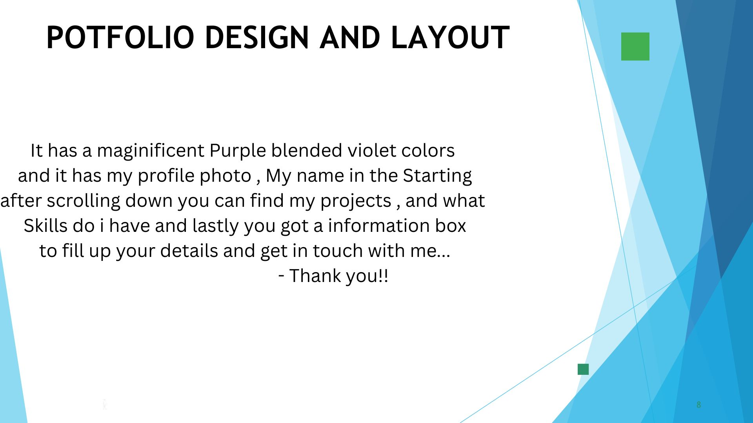
PORTFOLIO DESIGN AND LAYOUT
8

Slide 9
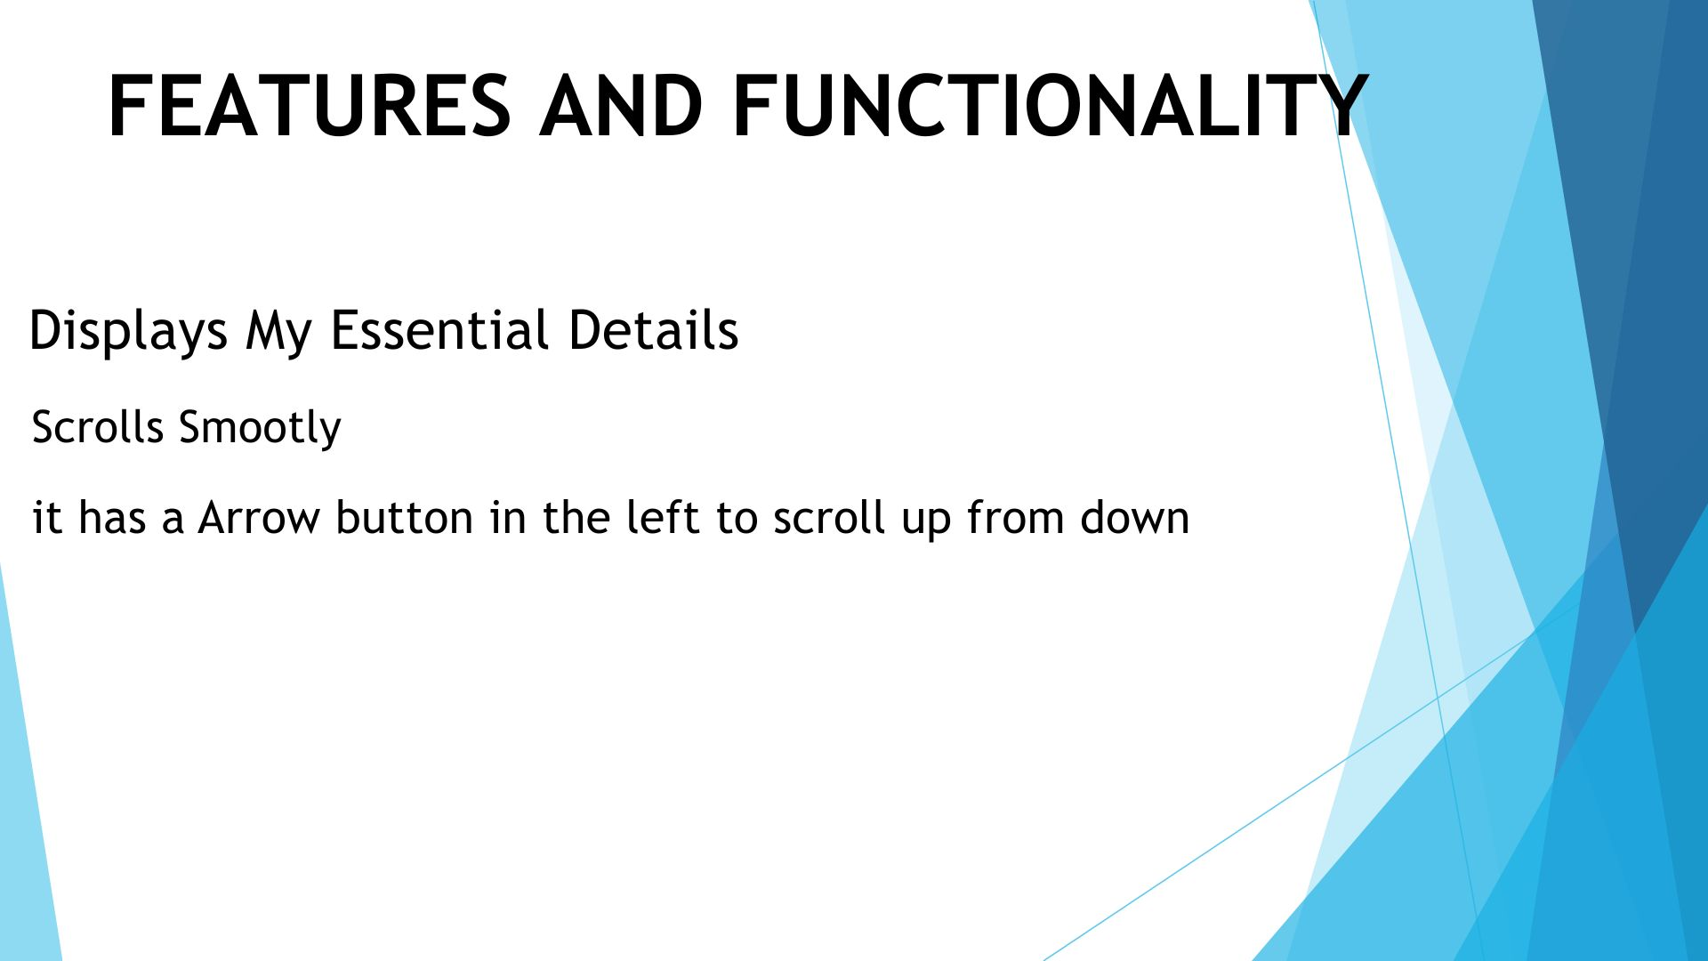
FUNCTIONALITY
FEATURES AND

Slide 10
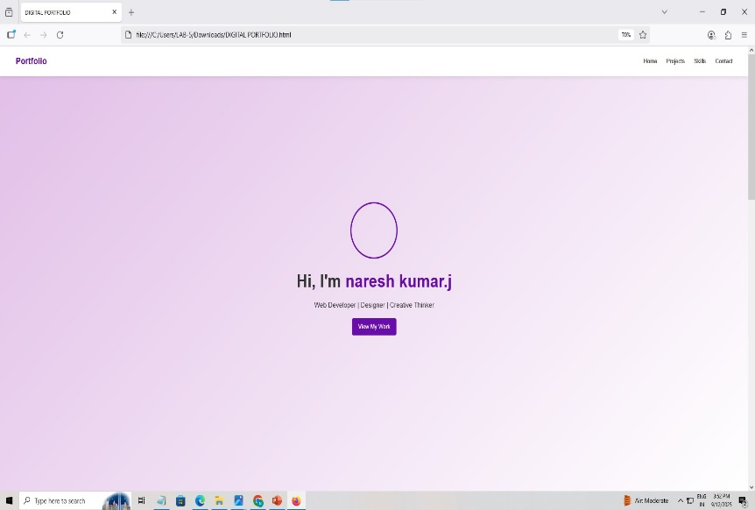
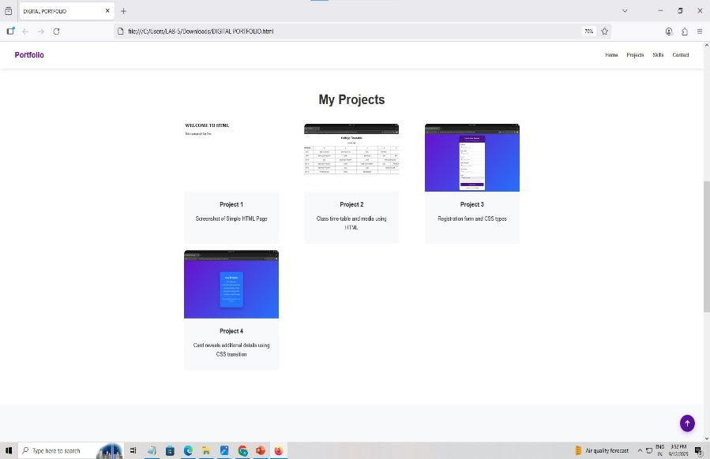

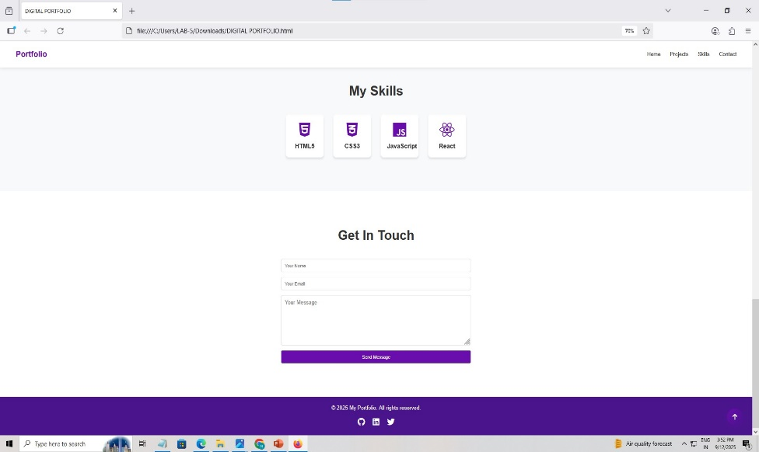
RESULTS AND SCREENSHOTS
3/21/2024 Annual Review
10

Slide 11
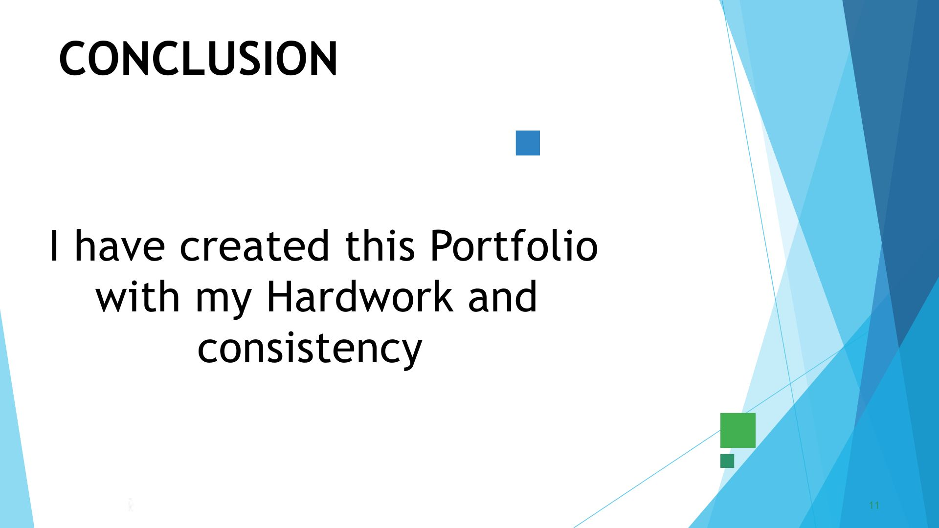
CONCLUSION
Github link: https://github.com/nareshkumar28122006/TNSDC-FWD-portfolio.git
Portfoliolink:https://nareshkumar28122006.github.io/TNSDC-FWD-portfolio/
11

